Slide 1
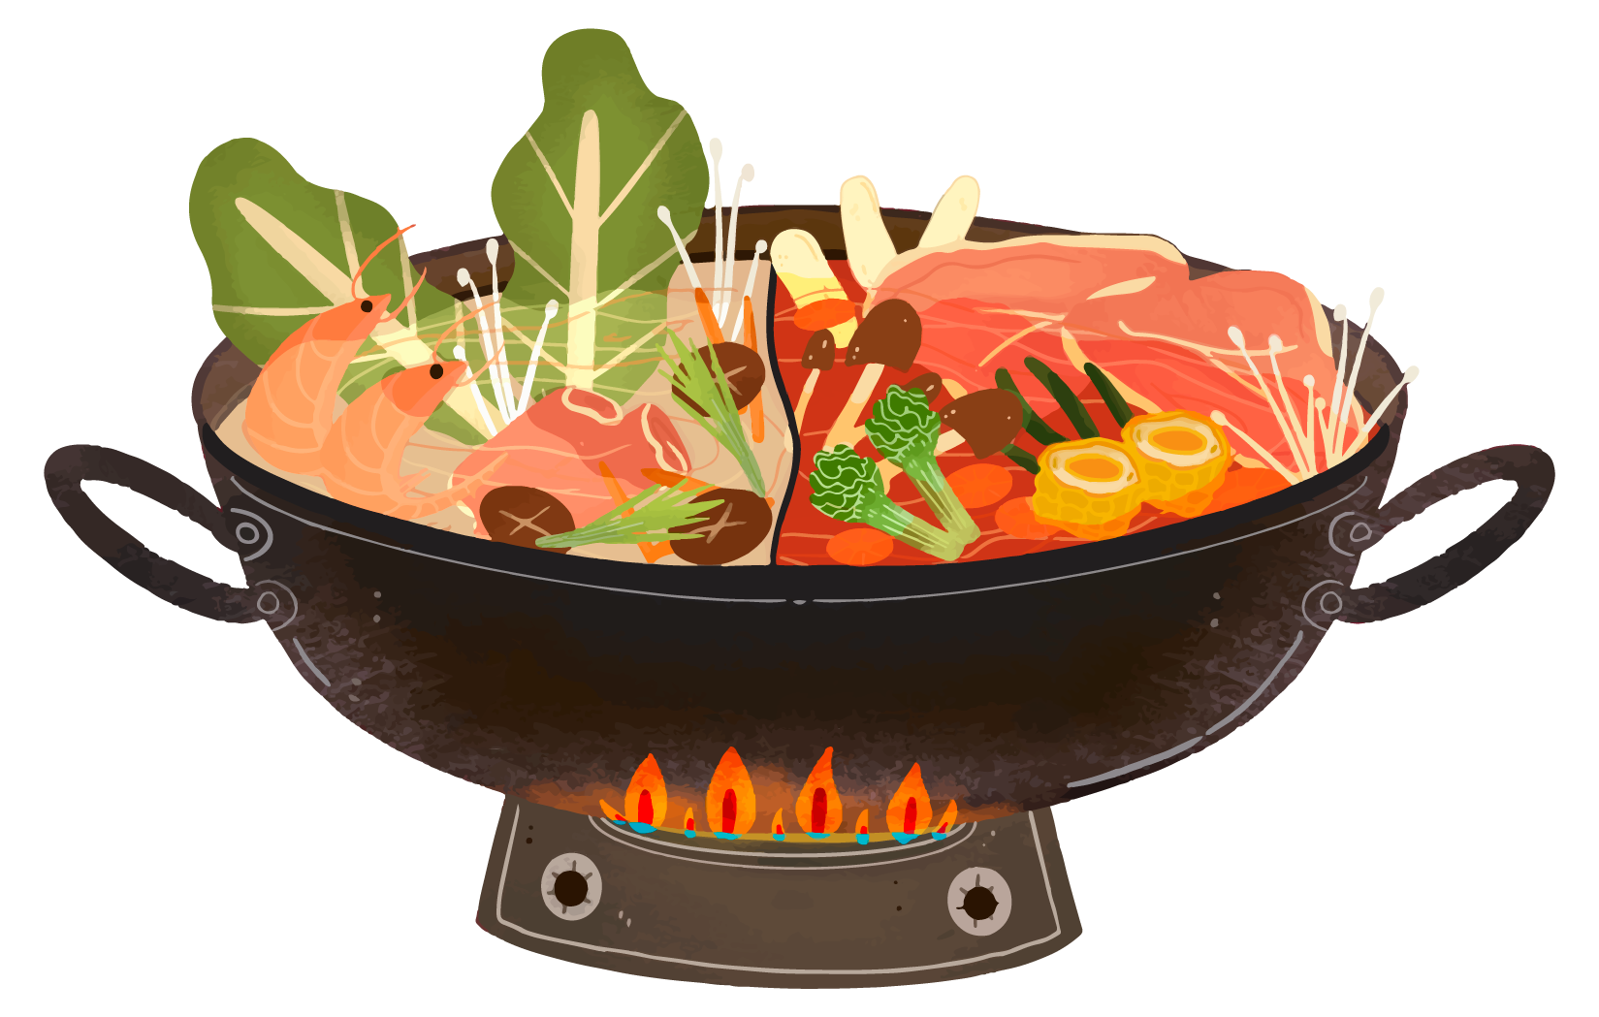

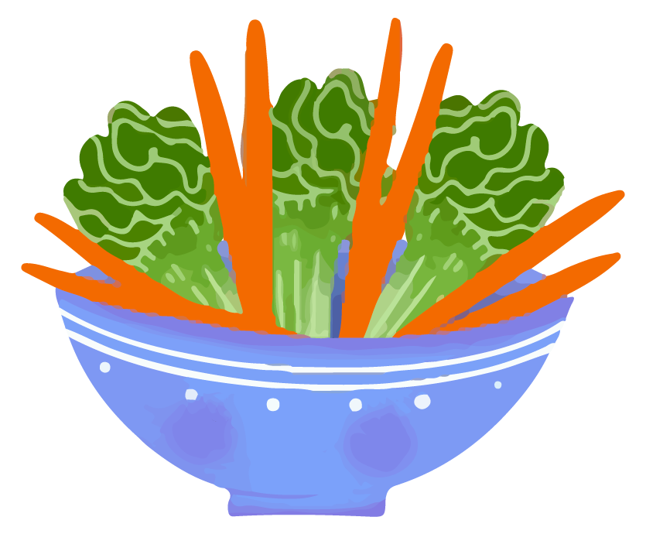
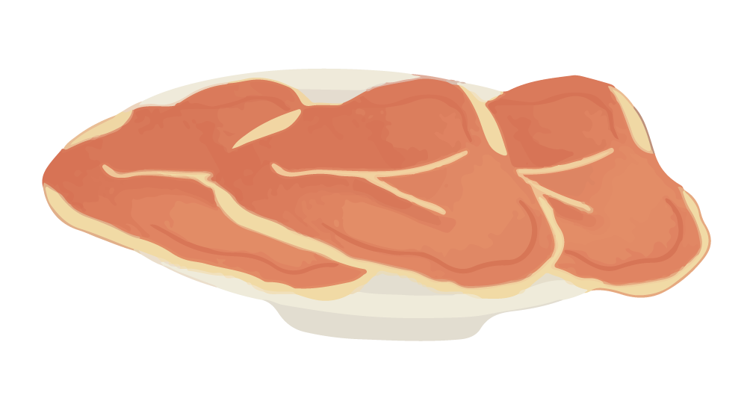
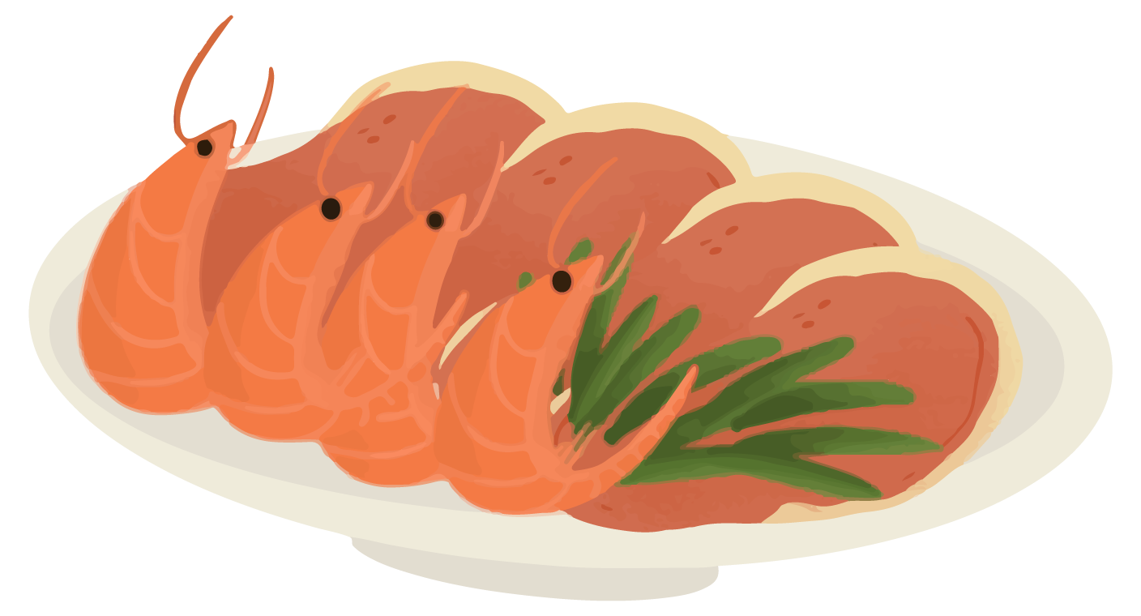
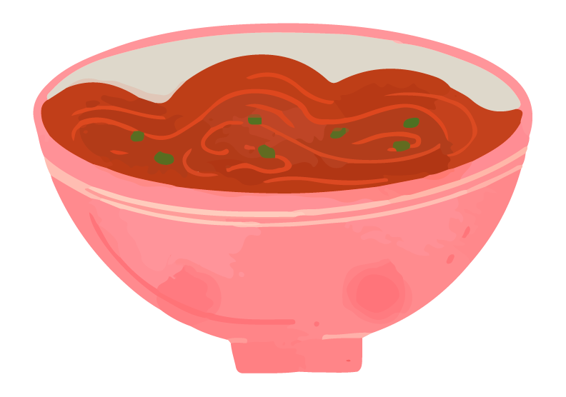
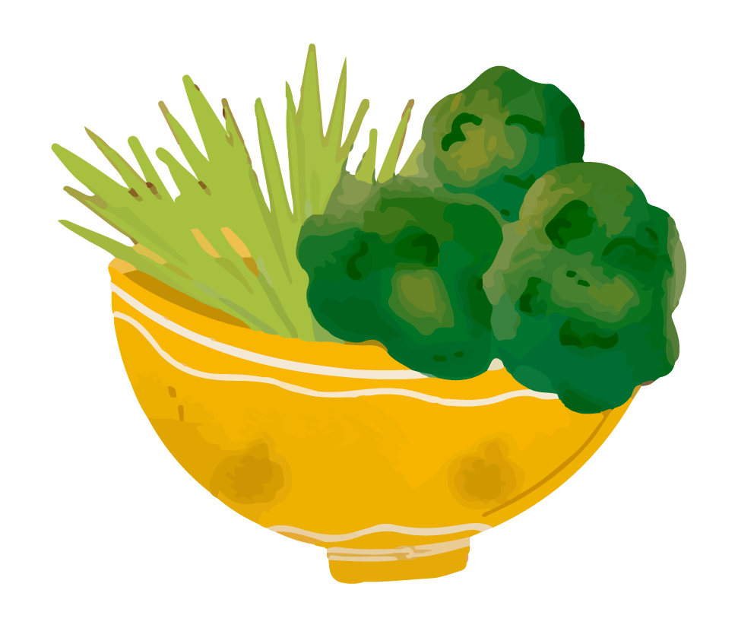
Hotpot Fusion: LLM Empowers Better Prompt for Diffusion Models
Group 8

Slide 2
TABLE OF CONTENTS
01
02
03
04
05
Background
Problem Statement
Method
Demonstration
Conclusion

Slide 3
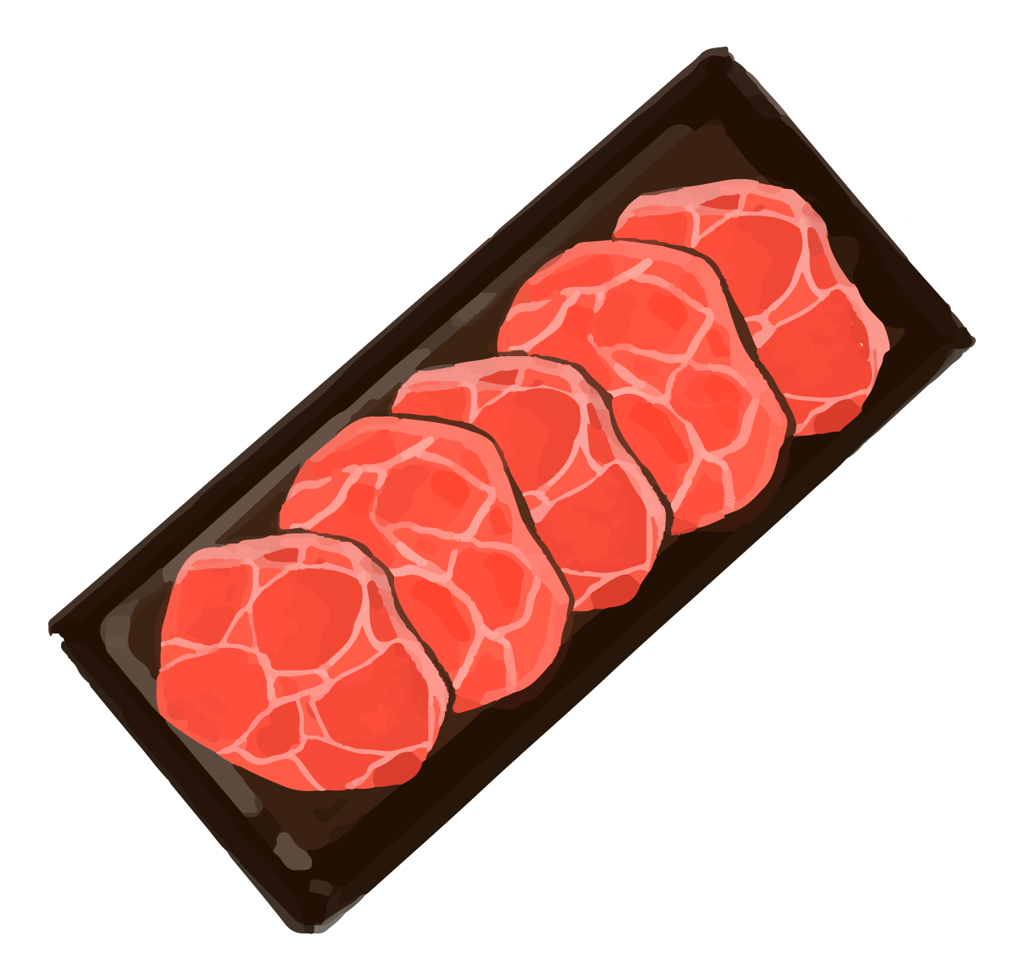
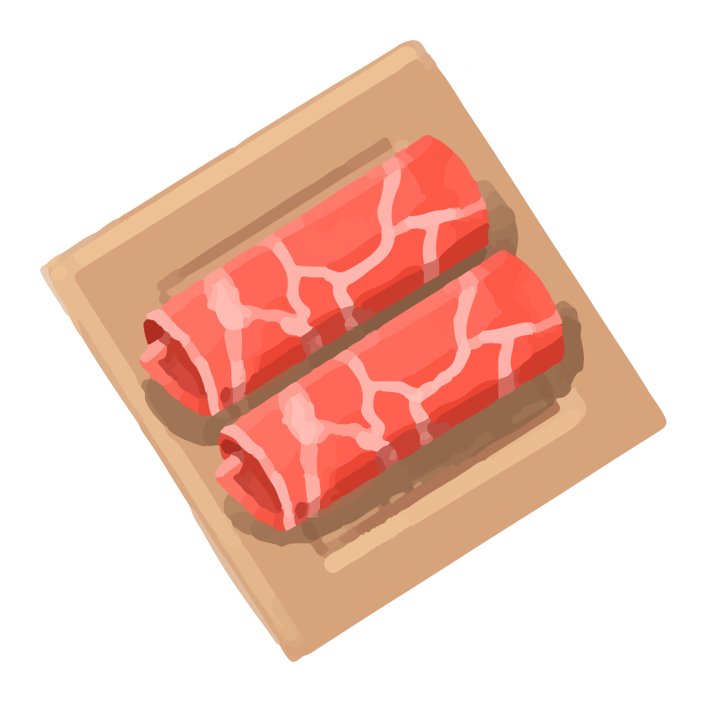
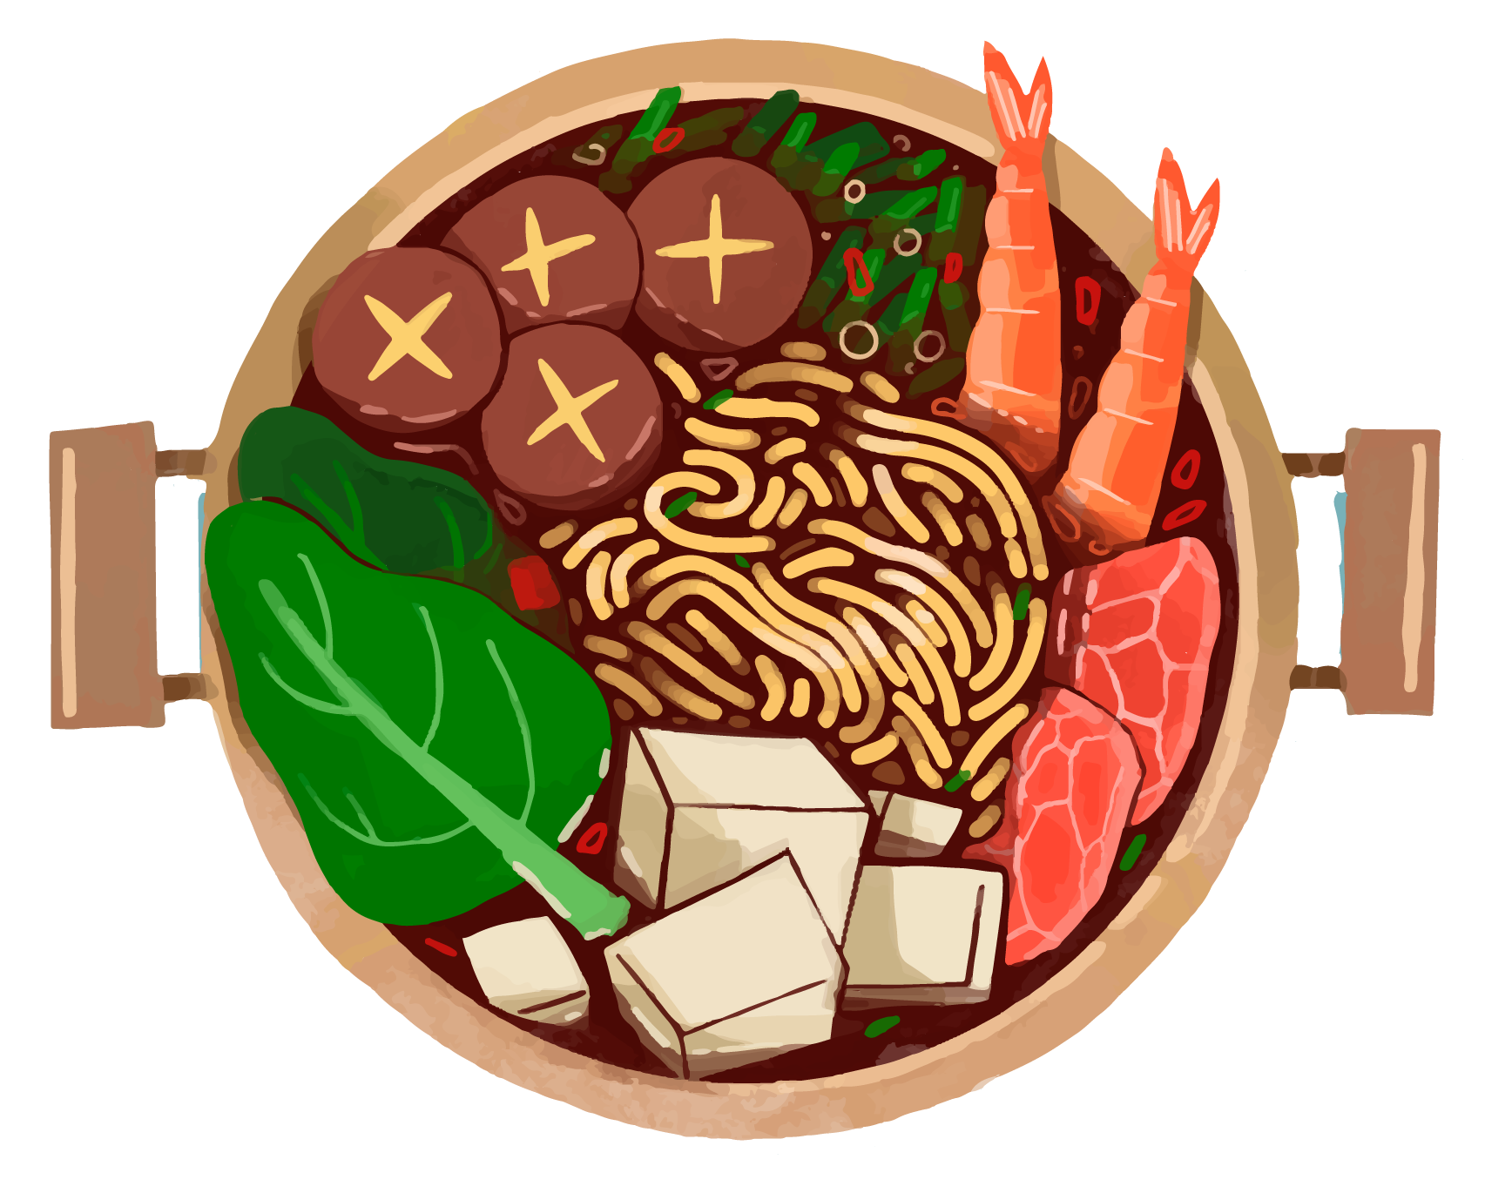

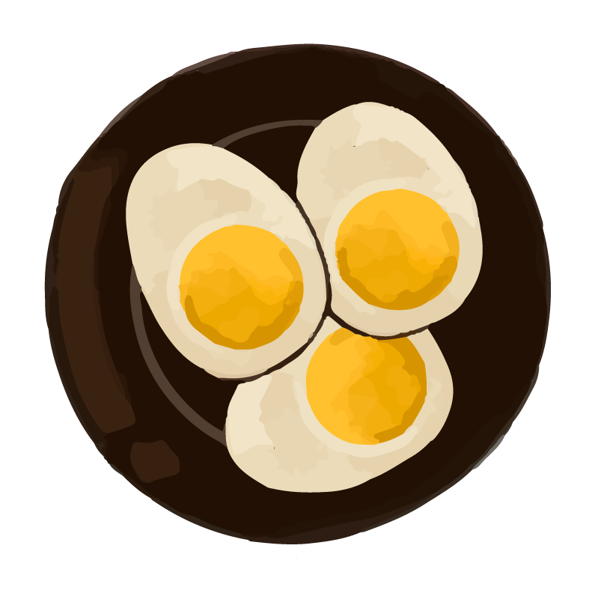
01
Background

Slide 4

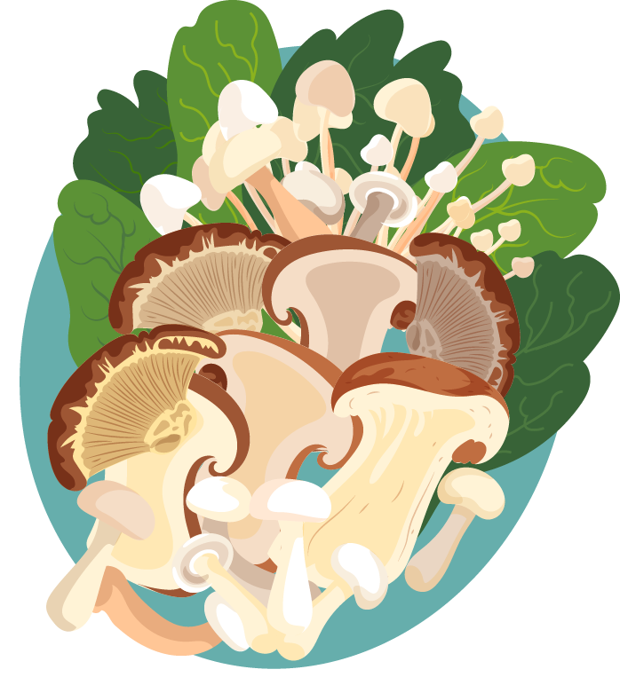
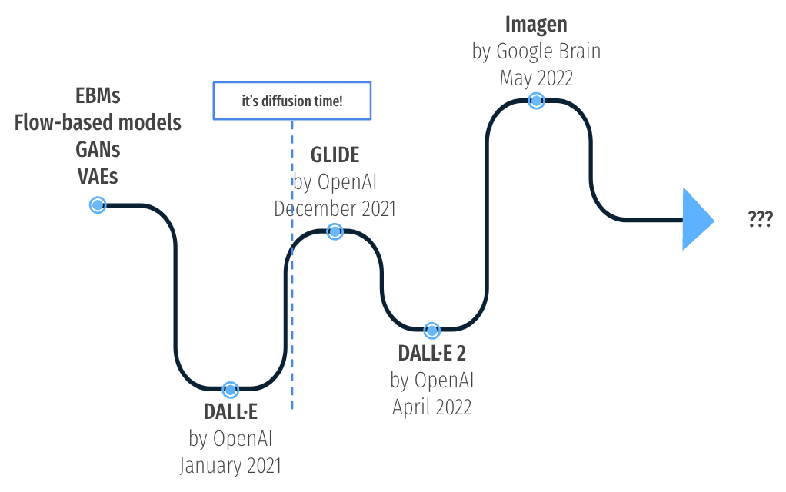
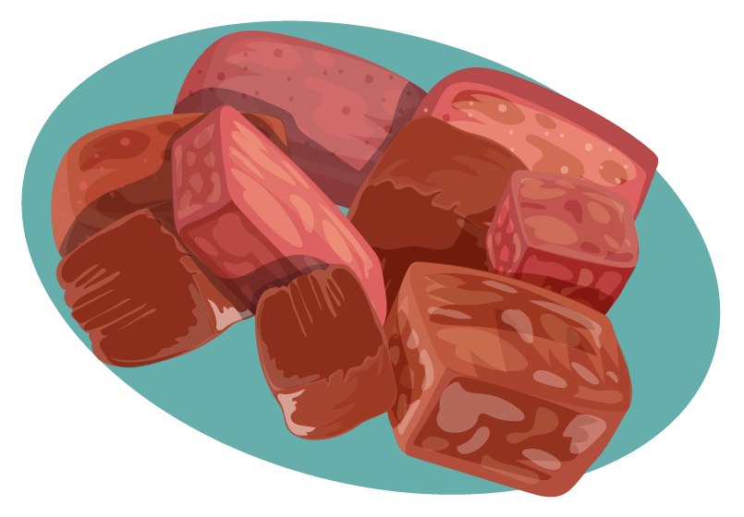
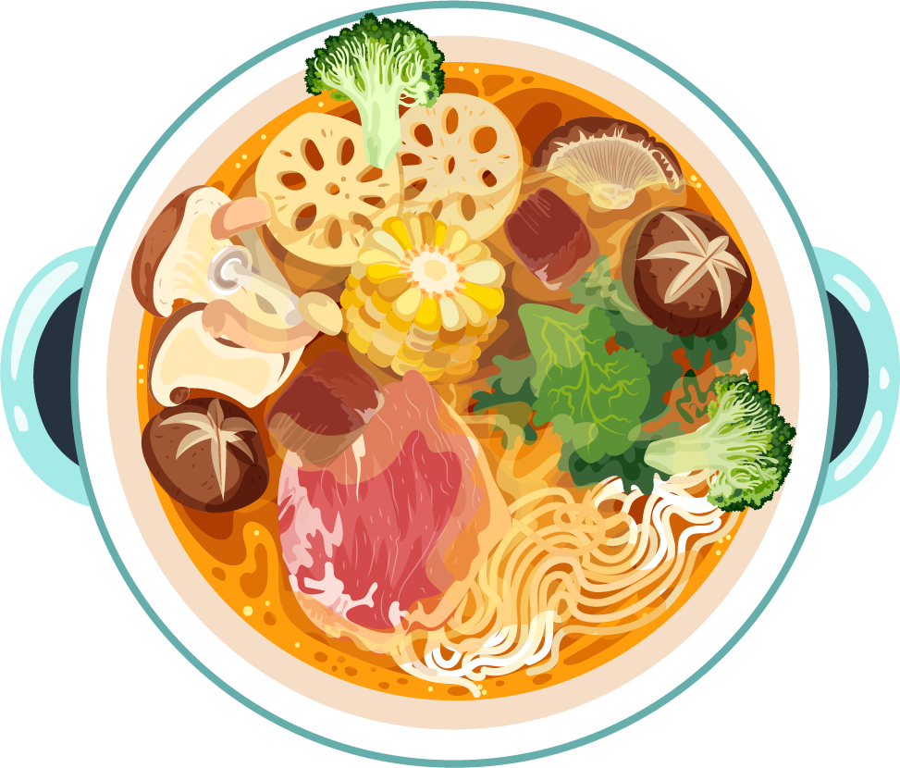
Introduction Text-to-Image Models
Notes:
Text-to-Image (T2I) technology has seen impressive advances, generating photorealistic and aesthetically appealing images from textual descriptions.
T2I models are central to the current AI revolution, significantly impacting creative industries and media generation. Generative AI, particularly T2I models, enables artists, designers, and content creators to translate their visions into visuals quickly and efficiently.

Slide 5
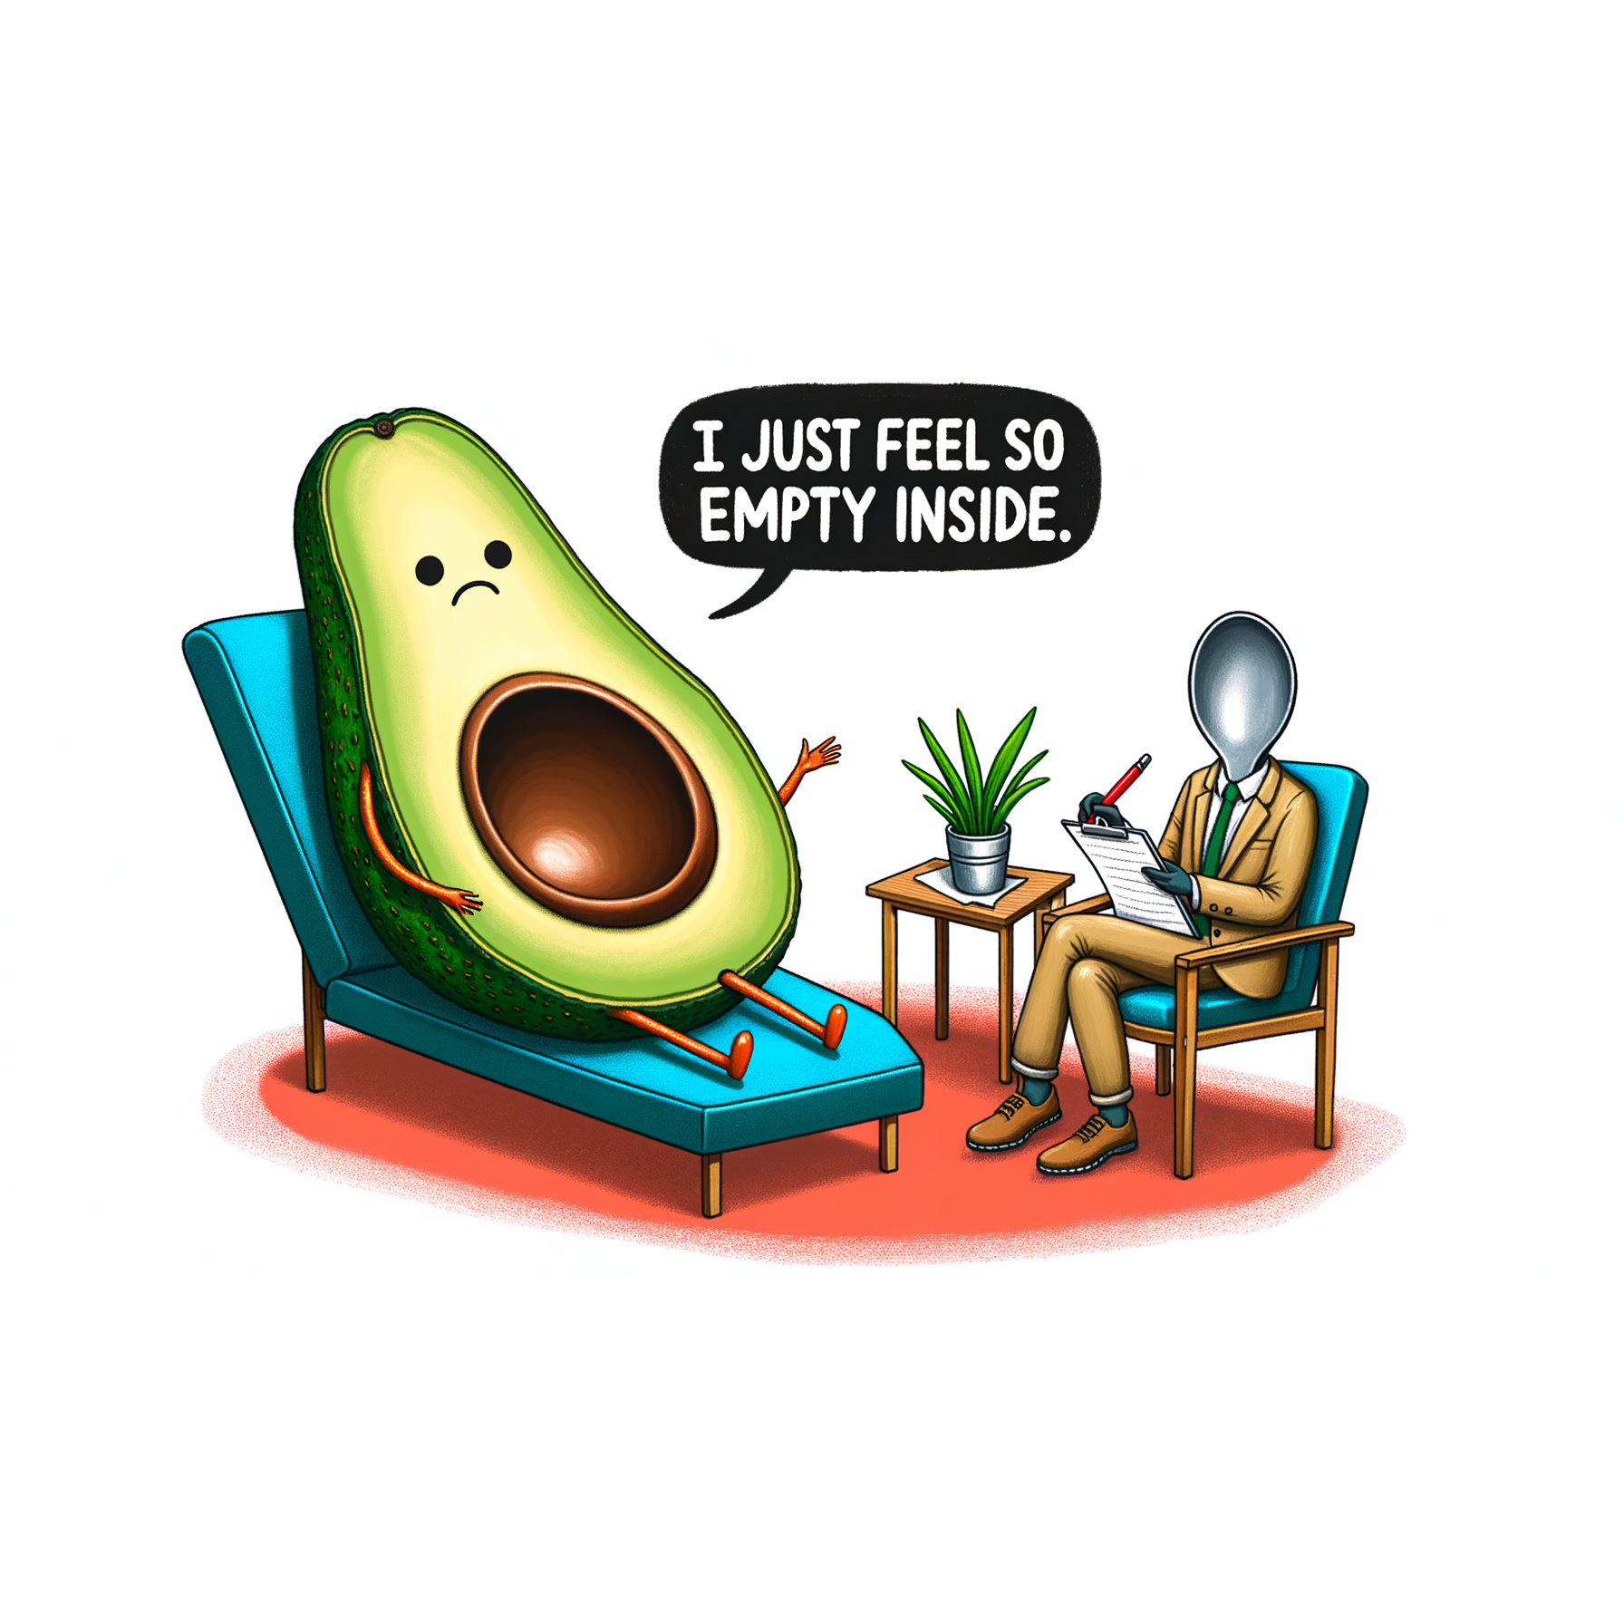
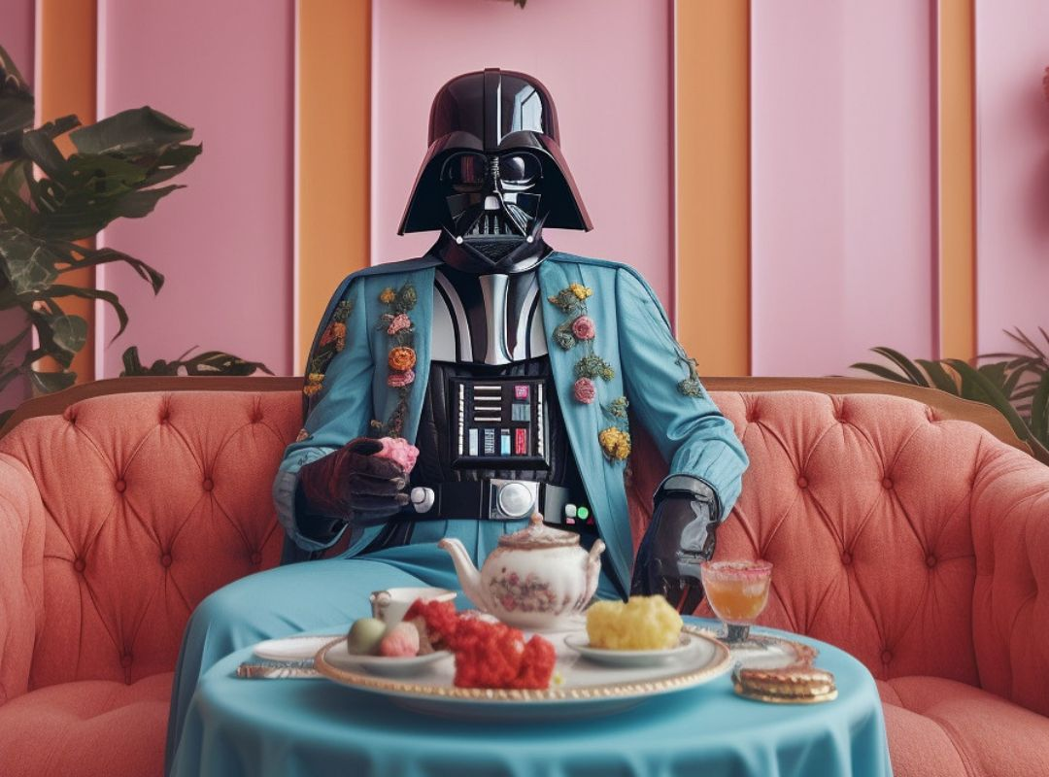
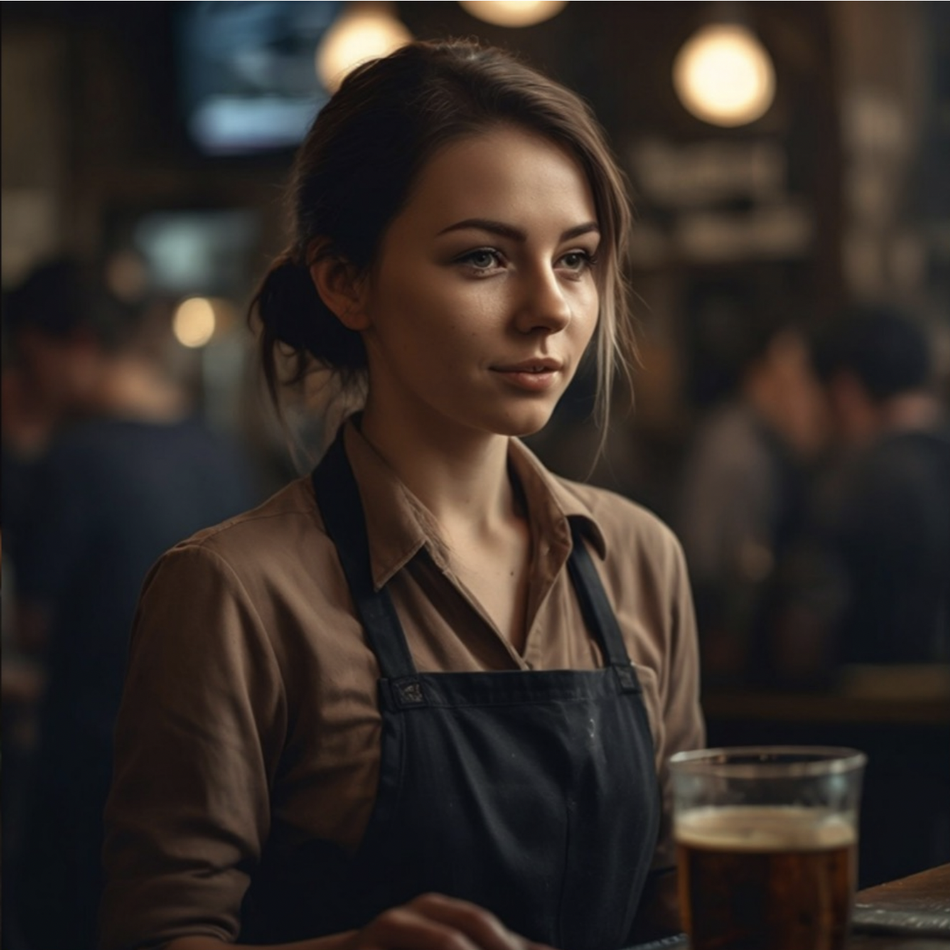
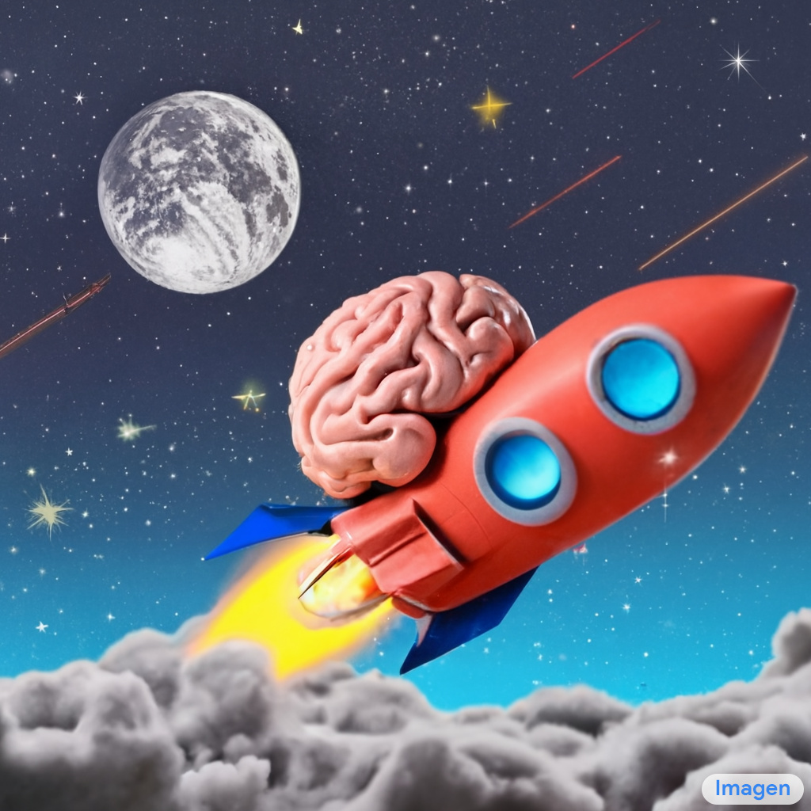
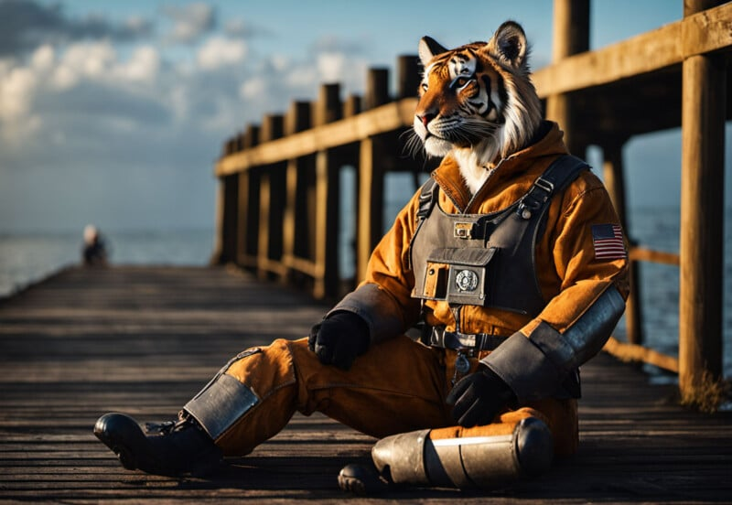
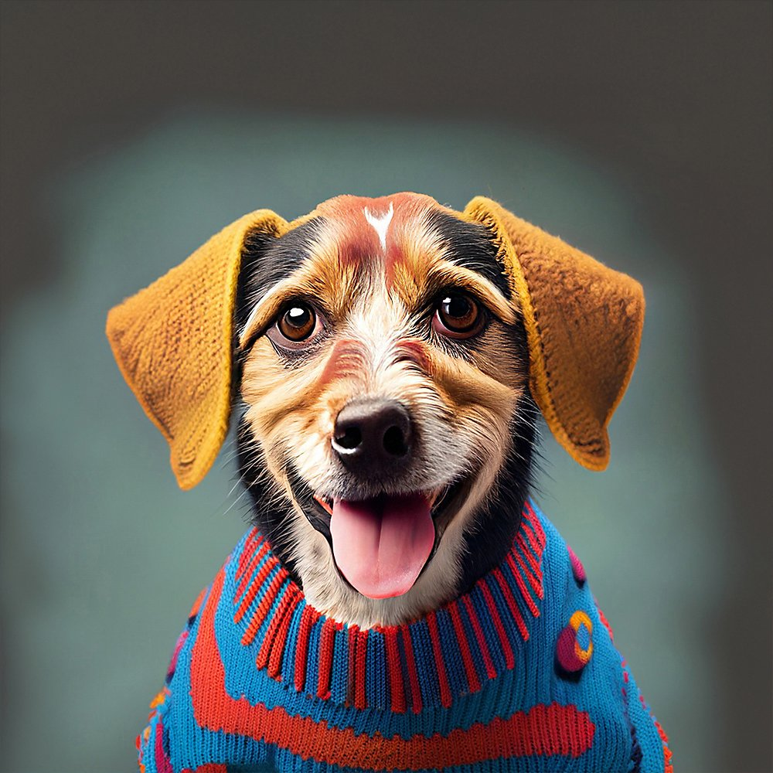
DALL-E 3 (OpenAI)
Midjourney
Emu (Meta)
Imagen (Google)
SDXL (Stability.ai)
Firefly (Adobe)
Notes:
There are several widely used t2i models in the industry, showing various probabilities.

Slide 6
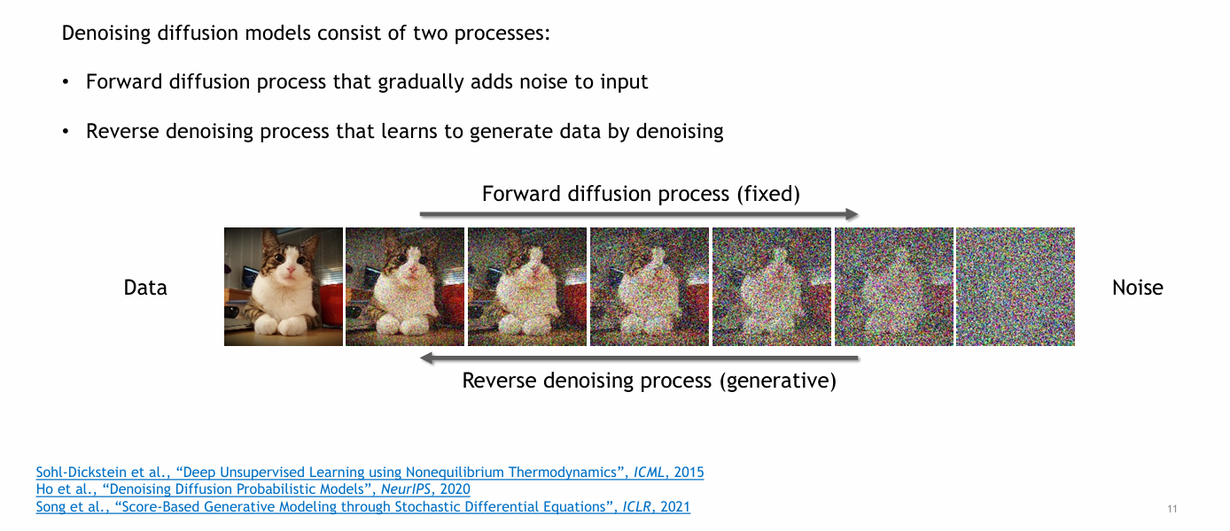
Diffusion Models
Slides borrowed from https://neurips2023-ldm-tutorial.github.io/
Notes:
Among the t2i models, diffusion models has went viral in recent years.
Diffusion models work by iteratively refining an image starting from random noise and gradually forming a coherent image.
These models are notable for their ability to produce high-quality, high-resolution images.

Slide 7
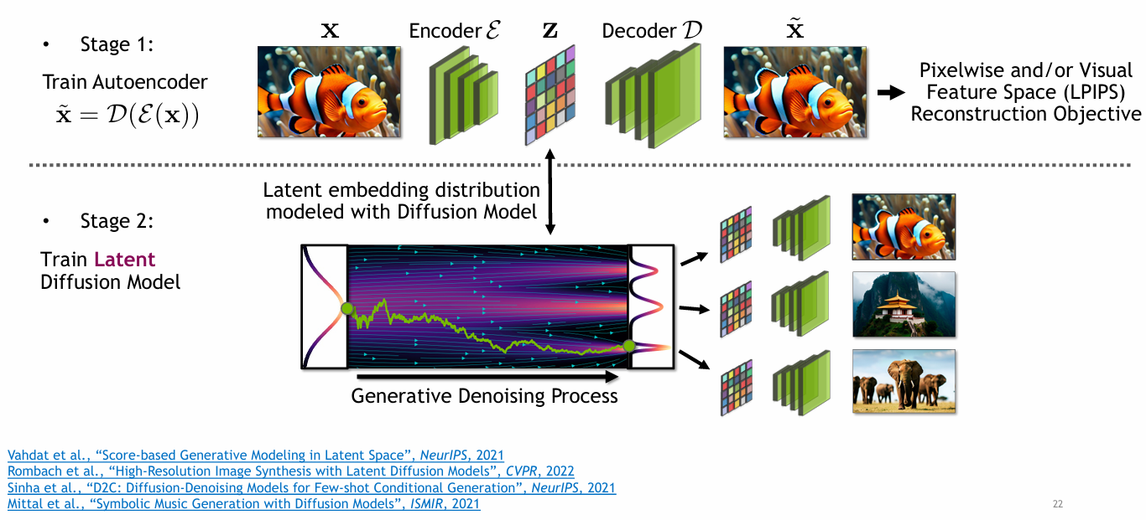
Latent Diffusion Models
Slides borrowed from https://neurips2023-ldm-tutorial.github.io/

Slide 8
02
Problem Statement

Slide 9
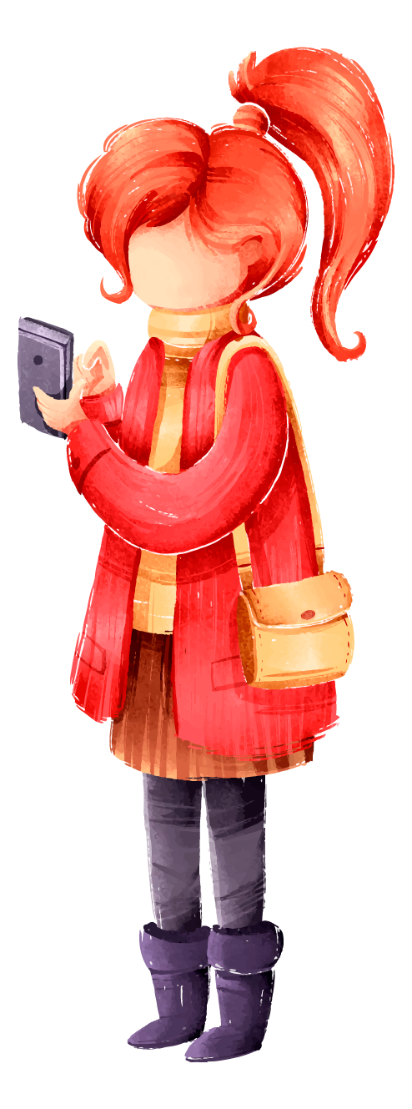
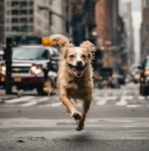
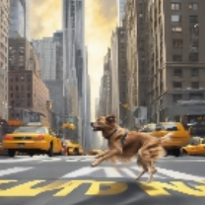
Suboptimality of Arbitrary Prompts
User-generated prompts can often be vague or suboptimal, resulting in image outputs that do not match the user's intent. This misalignment can lead to unsatisfactory and inconsistent image generation.
e.g. Vague prompts such as "A running dog on the street in New York." which might yield a range of interpretations and varying results.

Slide 10
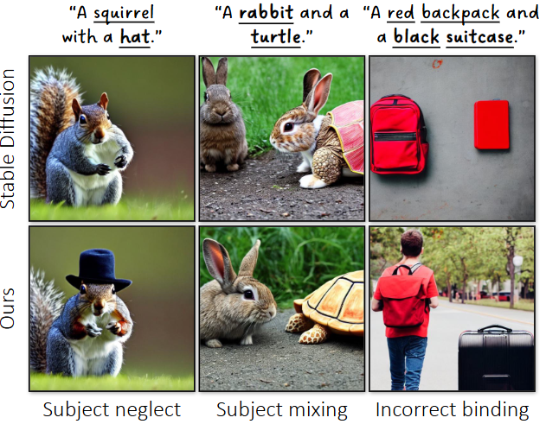
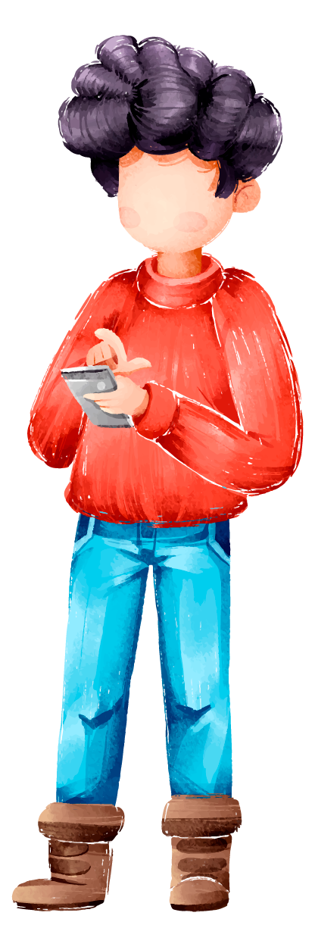
Current Challenges in Instruction Following
Subject Missing: Critical elements of the prompt may be omitted, leading to images that miss key subjects or details.
Attribute Binding: Ensuring that attributes are correctly associated with the intended subjects can be challenging, such as assigning the correct color to the right object within the generated image and the spatial relationships between objects..
INITNO: Boosting Text-to-Image Diffusion Models via Initial Noise Optimization,CVPR 2024

Slide 11
03
Method

Slide 12
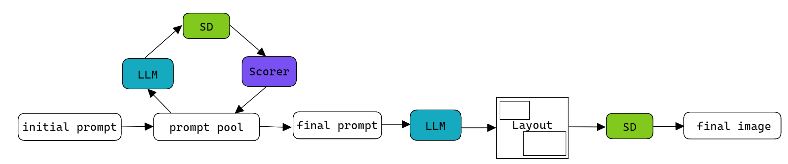
Overview of Proposed Method
a pre-trained T2I model
an LLM
an automatic prompt-image consistency score
Notes:
Our framework, involves a pre-trained T2I model, an LLM, and an automatic prompt-image consistency score – e.g., CLIPScore. Through ICL, the LLM iteratively improves a user-provided text prompt by suggesting alternative prompts that lead to images that are more aligned with the user's intention, as measured by the consistency score. At each optimization iteration, the in-context examples are updated to include the best solutions found so far.
Then, we select the best prompt from the prompt pool. And ask LLM to generate a layout from it. We use the layout to contrain the cross attention guide the diffusion process.

Slide 13
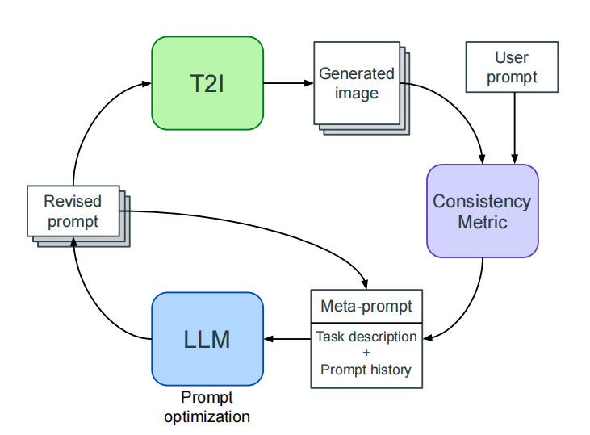
LLM as a Prompt Engineer
an iterative refinement of prompts to improve the consistency and quality of generated images.
By optimizing the prompts through a LLM-in-the-loop feedback, the method ensures that the generated images are more aligned with the user's original intent.
Notes:
解决 imprecise arbitrary
The proposed method involves an iterative refinement of prompts to improve the consistency and quality of generated images.
By optimizing the prompts through a LLM-in-the-loop feedback, the method ensures that the generated images are more aligned with the user's original intent.

Slide 14
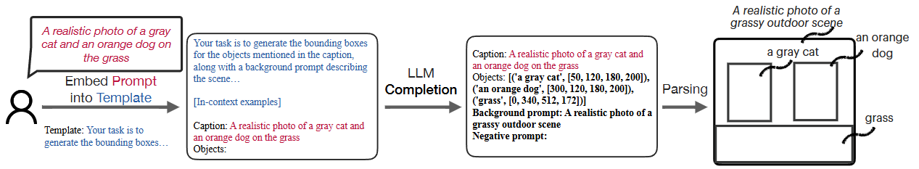
LLM as a Layout Generator
Instruct the LLM to generate the coordinates for the layout
with some ICL examples
Notes:
解决 missing & sptial

Slide 15
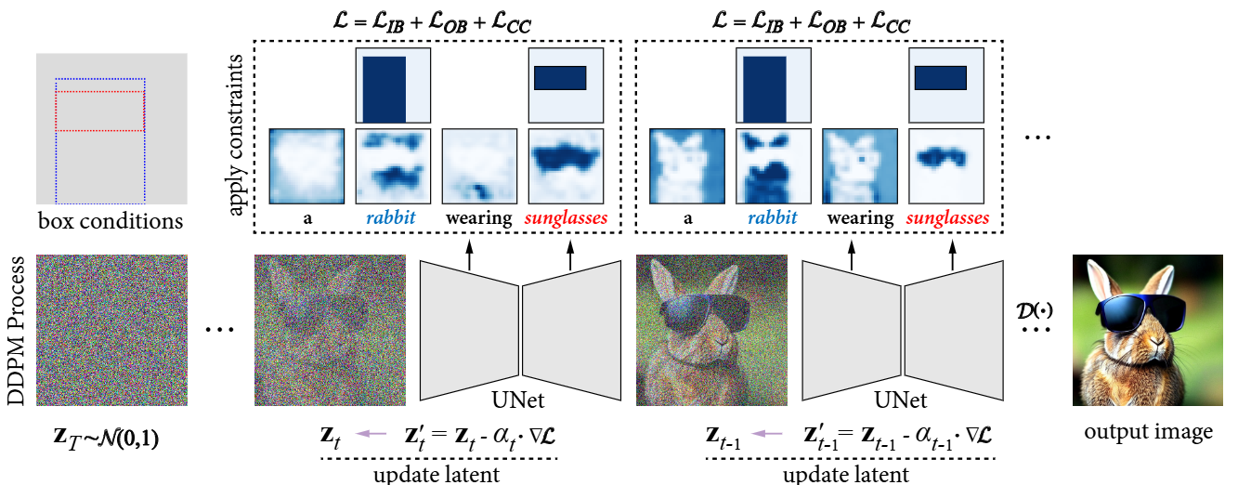
LLM as a Layout Generator
Boxdiff: Text-to-image synthesis with training-free box-constrained diffusion, ICCV 2023
Notes:
to ensure that high responses of cross-attention are only in the mask regions.

Slide 16
04
Demonstration

Slide 17
“A photo of a steaming hot pot filled with a roast duck, some noodles, some beef balls and some sea-buckthorn.”
“A vibrant image of a steaming hot pot brimming with tender roast duck, succulent beef balls, delicate noodles, and tangy sea-buckthorn, set in a cozy Chinese restaurant.”

Slide 18
05
Conclusion

Slide 19

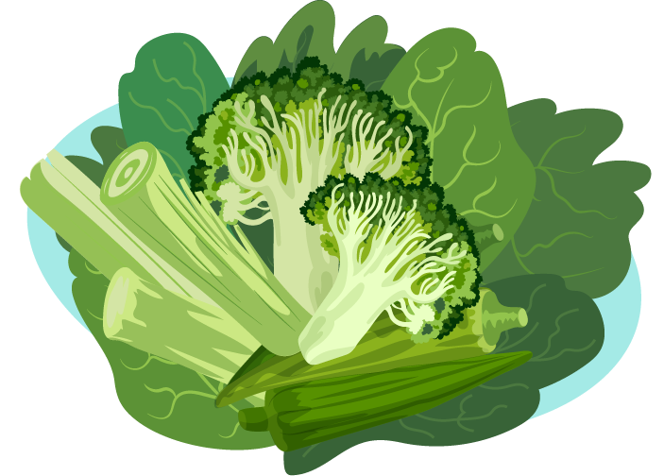
Summary of Benefits
Future Applications
This method enhances the relevance and quality of image generation from textual prompts, reducing the need for manual prompt adjustments and improving user satisfaction.
The technique has potential applications in various fields such as digital art, advertising, content creation, and beyond, where precise and consistent image generation from text is essential.

Slide 20
THANKS!

